Slide 1
Writing for Peer Review: How to write an abstract, manuscript, etc.
Lauren M Janczewski

Slide 2
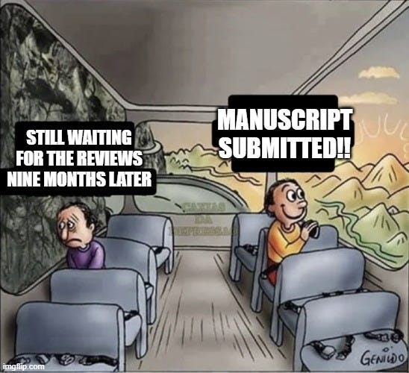
The Process is Long!
Project conceptualization
Acquire data
Data analysis
Write abstract/manuscript
PI editing
Co-author feedback
Peer review

Slide 3
Quick Tips
Write your methods/results section of your manuscript while you’re finalizing your analysis/preparing abstract for meeting
Use a reference manager: EndNote, Mendeley
Pick a target journal/meeting and (briefly) read their submission guidelines first
Check with your PI if they have a manuscript template/style they like to use first

Slide 4
How to write an abstract EB Day coming up, you can win money….

Slide 5
How to write an abstract
Step 1: Prior to writing, review abstract instructions carefully
Word / character count (+/- spaces)
Sections (e.g., introduction, methods)
Is a table or figure allowed? How does this effect the word count?
If you are submitting to a meeting, are you required to submit the article to a specific journal if accepted?
Do not use non-standard abbreviations
Write abstract with plenty of time to share with co-authors

Slide 6
How to write an abstract
Step 2: Title/Introduction
Title
For a meeting, choose a provocative title to spark the reviewers interest
Introduce the topic, but do not declare main findings or conclusion
Introduction
Introduce topic with a general big picture statement (1 sentence)
State the problem. Why is this study important and needed? (1-2 sentences)
List objectives: “Our objectives were 1) to…”. No more than 3 objectives at most (1 sentence)

Slide 7
How to write an abstract
Step 3: Methods
State data source(s) used and time period assessed
Discuss relevant exposure variables
Discuss comparison(s) made to answer the objectives outlined in the introduction and the specific method(s) used if relevant. Do not include simple methods (e.g., univariate statistics etc)

Slide 8
How to write an abstract
Step 4: Results
Summarize the unit(s) of analysis (hospitals, patients).
Provide general characteristics of the population and hospital setting evaluated, as relevant to your objectives
Summarize exposure variable(s), if appropriate (e.g., treatment A, treatment B etc)
Discuss the results of the analyses as it relates to each objective
DO NOT make any editorial or concluding statements in results

Slide 9
How to write an abstract
Step 5: Conclusions
Summary statement of main findings, as it relates to stated objectives.
Statement on the implication(s) and meaning of this study in a broad context.
Statement on next step(s)
A good rule of thumb: Send to PI no later than 2 weeks before deadline, send to co-authors no later than 1 week before deadline

Slide 10
Other Tips….
You should (roughly) aim for a 1:1 ratio between abstracts/presentations and manuscripts
Some slicing and dicing is occasionally okay
If the abstract/presentation doesn’t turn into a published manuscript, it never happened….
Fellowship directors will look for this explicitly (caveat: I haven’t even applied to fellowship yet)

Slide 11
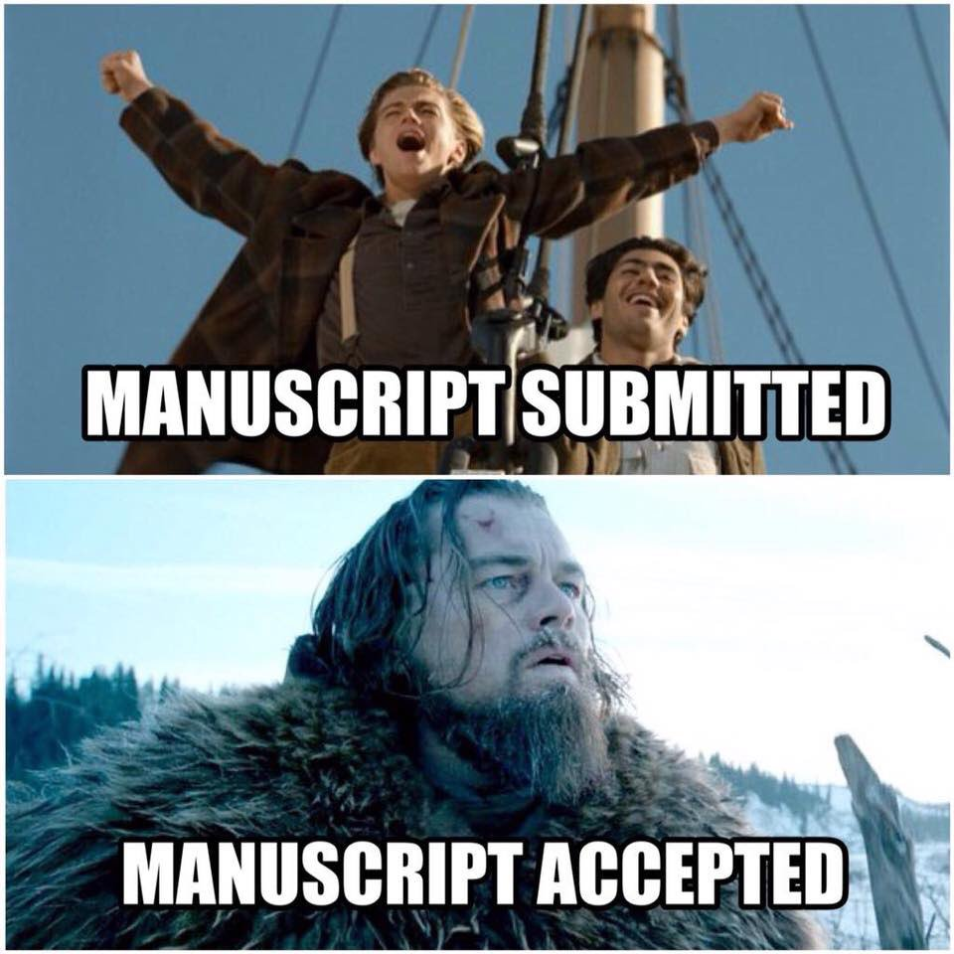
How to write a manuscript

Slide 12
How to write a manuscript
Style points:
Use 1” margins all around
Arial or Times, size 11 or 12 font
Insert page number on bottom right (“Page X of Y”)
Double space the whole document (Except References, Tables, and Figures)
Start each new section on a new page (i.e., insert page breaks for Introduction, Methods, Results, Discussion, References, Tables, Figures). Each individual Table or Figure is on a new page of its own.

Slide 13
How to write a manuscript
Introduction
First paragraph: overview of the problem and why it is important.
Second paragraph: describe what’s known and then the gap in knowledge
Third paragraph: Tie the overview and gap together in the first sentence or two
Explain why the work will be significant/novel
State your objectives: “The objectives of this study are (1) to examine…, (2) to assess…., and (3) to ….”
Sometimes you need to give a hypothesis, but often the objectives are sufficient.
Don’t discuss specific papers in Intro unless absolutely critical.
IMPORTANT: Your objectives should be same in Abstract and Introduction (can have slightly different wording to accommodate Abstract word limit) and these objectives should be the organization for the rest of the paper in the Results and in the Discussion.

Slide 14
How to write a manuscript
Methods (all separate subheadings)
Data Source
Describe where the data came from
Describe quality of data a little – how validated?
Typically a good spot for IRB statement
Study Population
Describe how you selected your patients (inclusion/exclusion). Give “N”s for those excluded at each step.
Independent Variables
Outcomes
Statistical analysis
Univariate analysis
Multivariable analysis and variables included in models, Model specifications
Include how you handled missing data, confounding, etc
Sensitivity Analyses
Disclaimer: I know nothing about basic science!

Slide 15
How to write a manuscript
Results
Overview/describe the key features of the patient population.
Overview of a typical Table 1 (key patient demographics). Don’t just convert Table 1 into text. Less is more.
Objective 1 results
Objective 2 results
Objective 3 results

Slide 16
How to write a manuscript
Discussion
First paragraph:
1-2 sentences: Restate the problem briefly and why it is important
1-2 sentence overview of the findings of your study
Sometimes a policy implication sentence without editorializing too much
Second-third or fourth paragraph: Objective 1-3 (each objective is one paragraph)
Describe what others have found – briefly (key studies) (“The landmark XXX trial found…”)
Describe what you have found and why it adds to what was known previously
Tie together 1 and 2
Limitations paragraph
+/- Implications paragraph
Conclusion

Slide 17
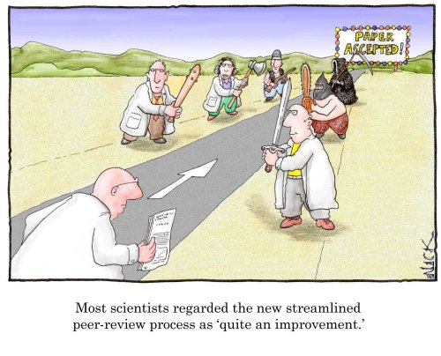
Peer Review

Slide 18
Peer Review
Editors/Reviewers want to see red
Write an itemized response letter by reviewer and comment, each of which has a response
Be thankful without being annoying
“We apologize for the oversight.”
“We thank you for this comment and the opportunity to improve our manuscript.”
On letterhead, sign “warm regards”

Slide 19
Questions?

