Slide 1
Data Visualization for Biomedical Research
Bowen Wang, PhD
Assistant Professor of Surgery
Department of Surgery
Feinberg School of Medicine, Northwestern University
bowenwang@northwestern.edu

Slide 2
Disclosure
I have no relevant financial relationships with commercial interests

Slide 3
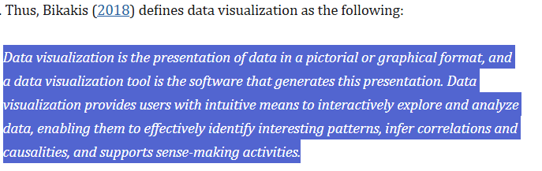
What is DataViz?
Embodying Data. 2020 Jun 20:17–47. doi: 10.1007/978-981-15-5069-0_2

Slide 4
Why DataViz?
clarify complex or large data.
generate broader interest from the research community.
improve analysis.
tell a story.
identify relationships between data.
reveal trends.
communicate results.
enable insights.
reveal outliers.
https://datascience.cancer.gov/training/learn-data-science/visualize-data-basics
Notes:
If no figure is needed, then no figure.

Slide 5
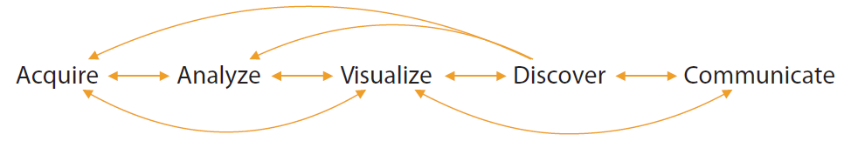
Role of DataViz in Research
Annu. Rev. Biomed. Data Sci. 2018. 1:275–304
Notes:
DataViz is often a necessary and rate-limiting step in both discovery and communication. BTW the fact that they even had to make a figure is very ironic.

Slide 6
DataViz for SciComm
Annu. Rev. Biomed. Data Sci. 2018. 1:275–304

Slide 7
DataViz for SciComm
Who’s the target audience?
Annu. Rev. Biomed. Data Sci. 2018. 1:275–304

Slide 8
DataViz Strategies for Different Purposes
Scientific publication
Conference presentation
Grant proposal
Graphic abstract
Scientific dissemination to the general public
Notes:
We will come back to this later

Slide 9
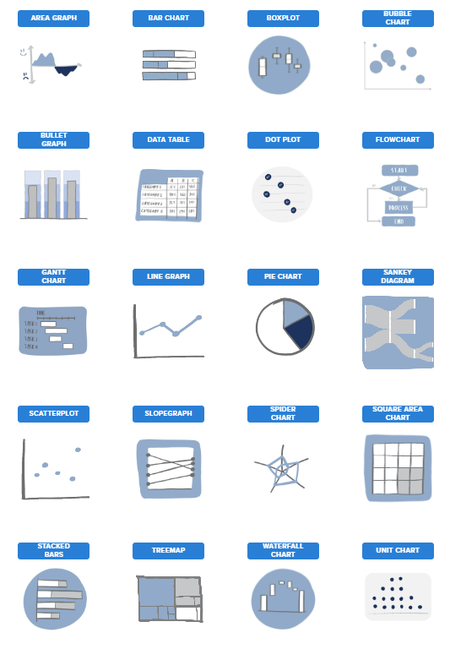
DataViz
https://www.storytellingwithdata.com/chart-guide

Slide 10
Do you really need a fig for that?
https://www.storytellingwithdata.com/chart-guide

Slide 11
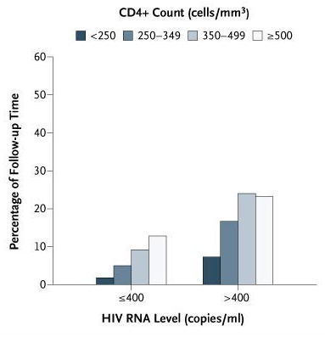
Could have been a table
https://www.nejm.org/doi/full/10.1056/NEJMoa062360

Slide 12
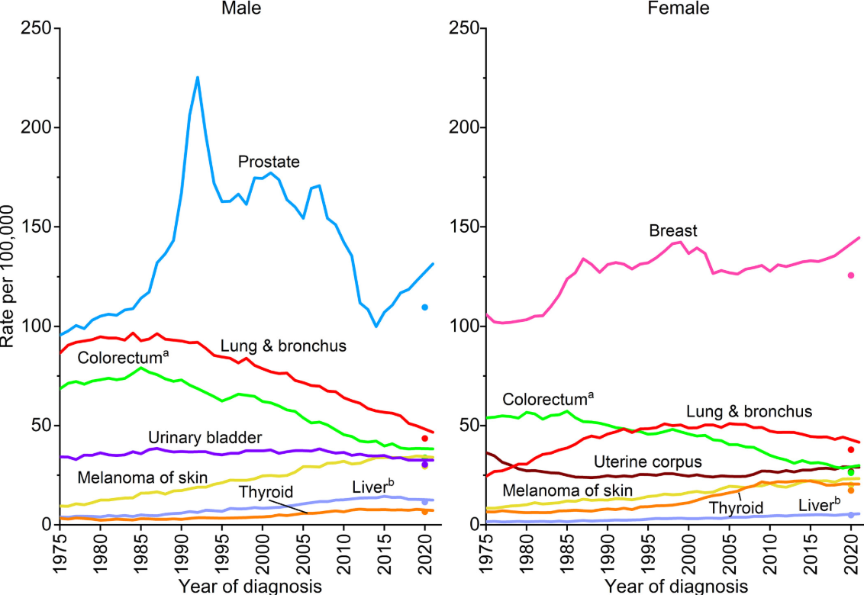

Both fig and table
Trends in incidence rates for selected cancers by sex, United States
https://acsjournals.onlinelibrary.wiley.com/doi/10.3322/caac.21871

Slide 13
From data to graph
Excel
GraphPad Prism, etc.
SAS, SPSS, STATA, etc.
R (the “tidyverse”: ggplot, tidyplot, etc.), Python (Matplotlib), and other coding languages
Notes:
Construct graphs brick by brick

Slide 14
Types of graph
https://www.storytellingwithdata.com/chart-guide

Slide 15
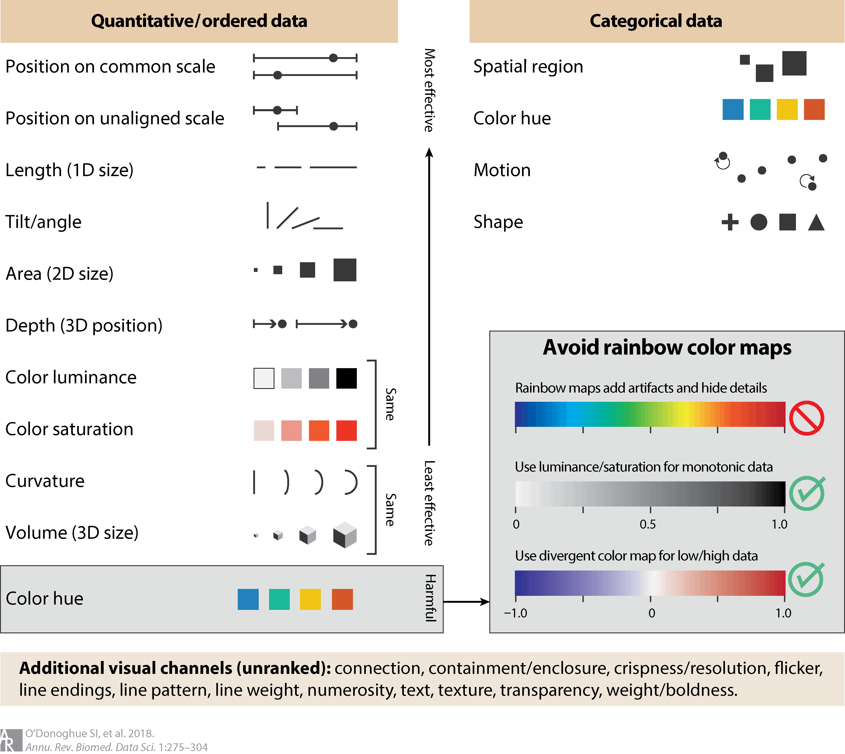
Notes:
3D bad…

Slide 17

Color

Slide 18
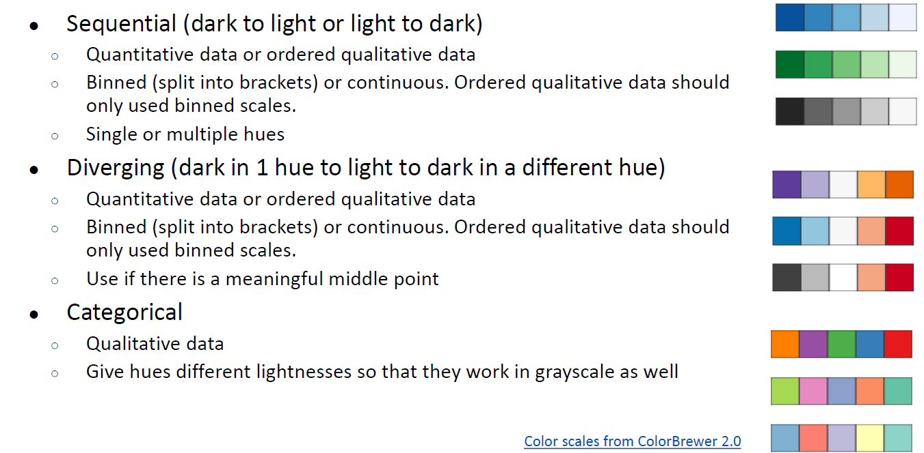

Slide 19
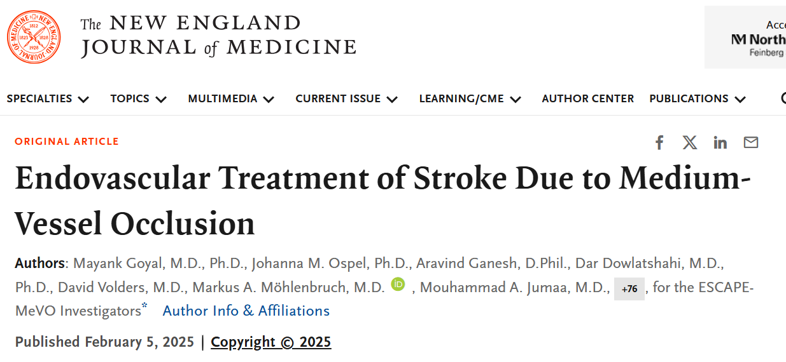
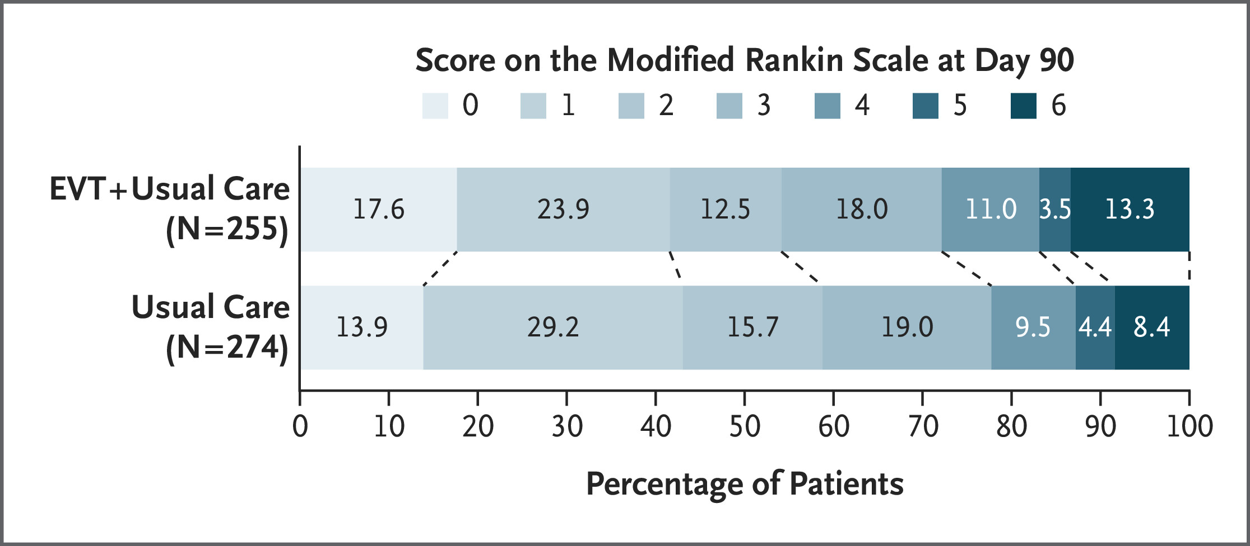
Color good?
https://www.nejm.org/doi/10.1056/NEJMoa2411668

Slide 20
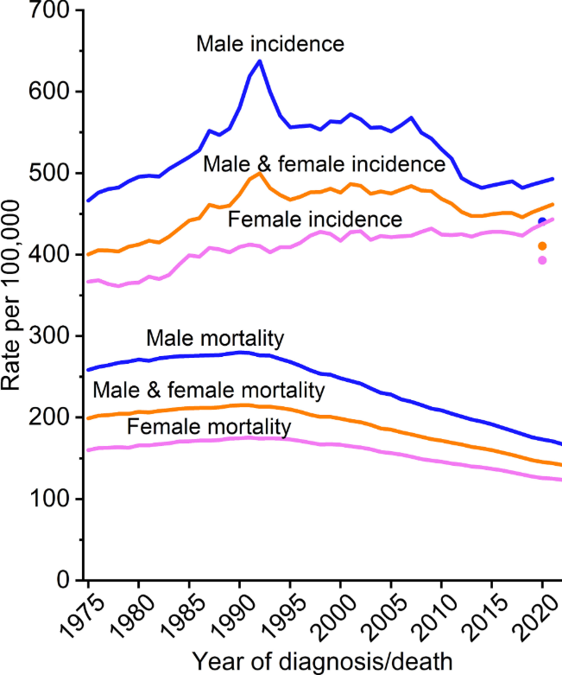
Color good?
https://acsjournals.onlinelibrary.wiley.com/doi/10.3322/caac.21871

Slide 21
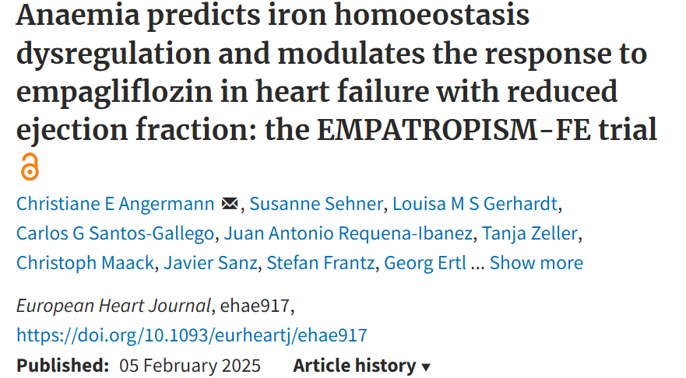
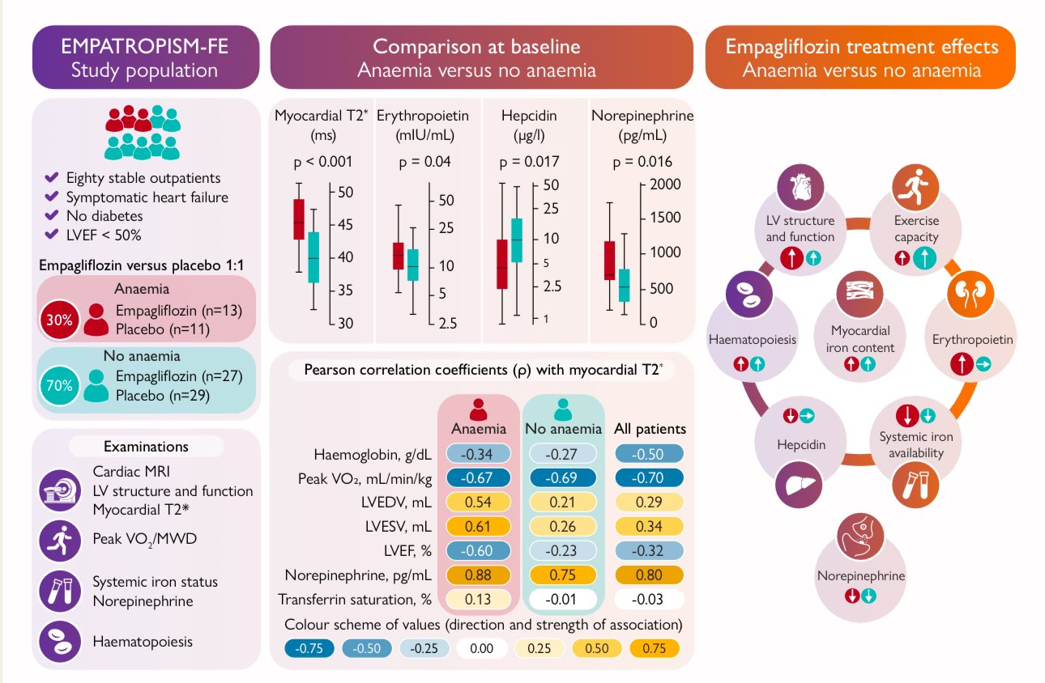
Color good?
https://academic.oup.com/eurheartj/advance-article/doi/10.1093/eurheartj/ehae917/8002476

Slide 22
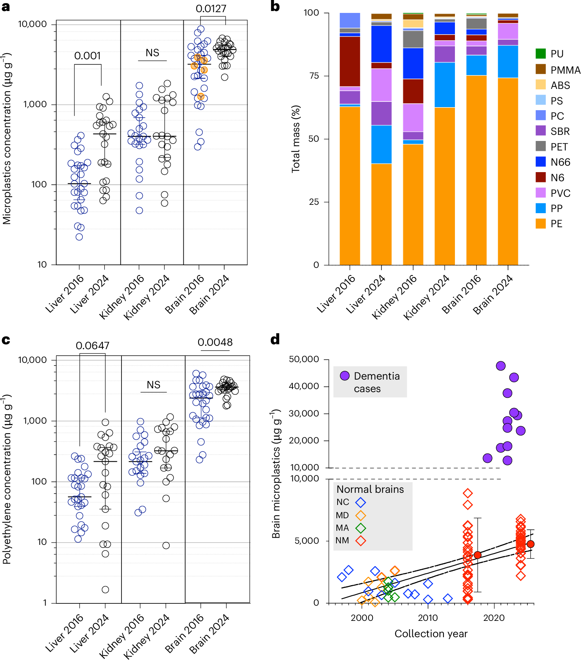
Color good or bad?

Slide 23
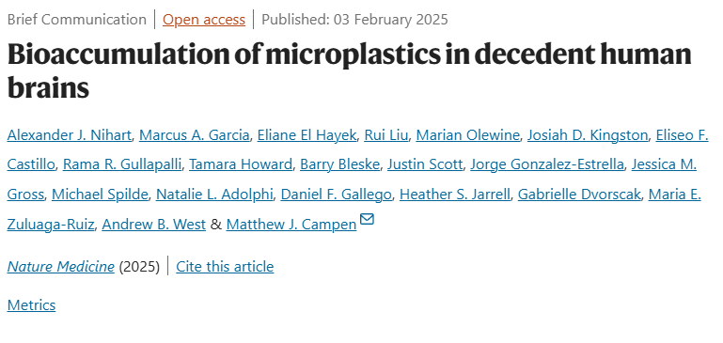
Color good or bad?
What else?
https://www.nature.com/articles/s41591-024-03453-1

Slide 24
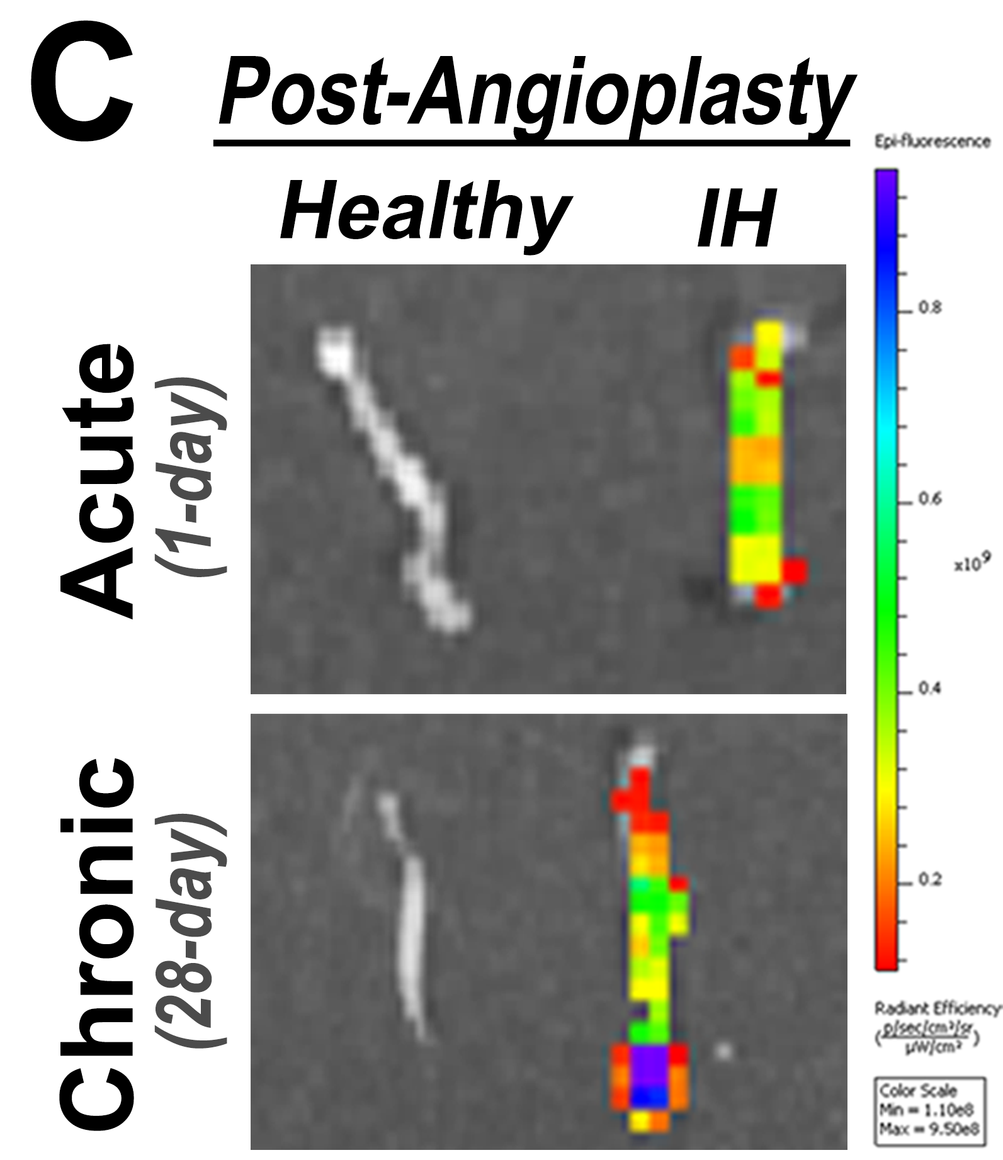
What’s wrong with this graph

Slide 25
Rainbow map + readability + common sense!

Slide 26
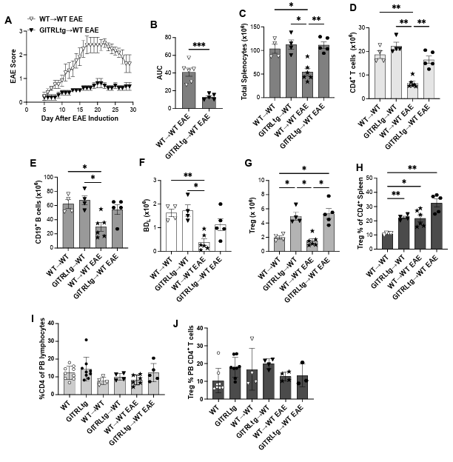
Inconsistent color scheme
Label: readability
https://www.biorxiv.org/content/10.1101/2025.02.04.636512v1

Slide 27
Color?
Gridline?
What else?
Hay et al. BMJ online Nov 11, 2006 p5

Slide 28
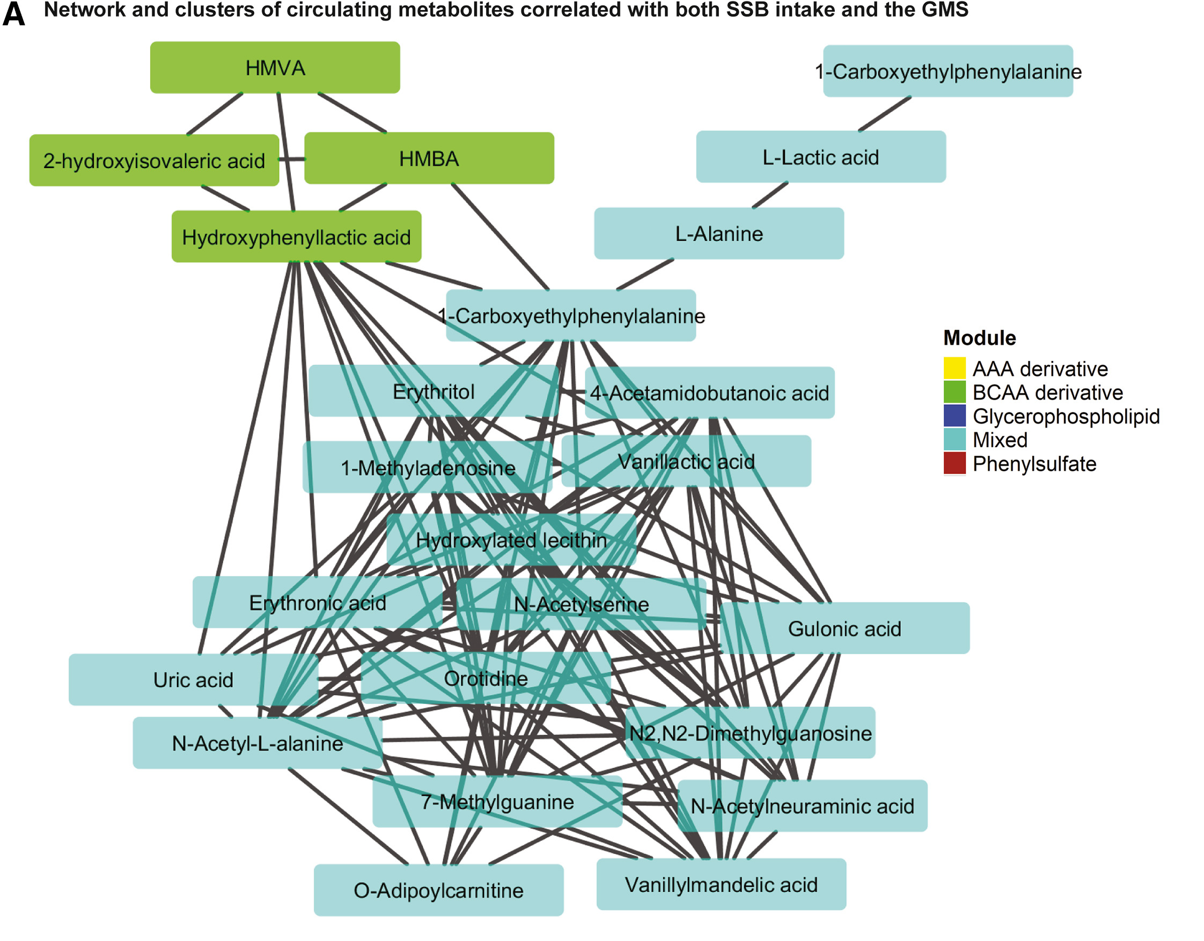
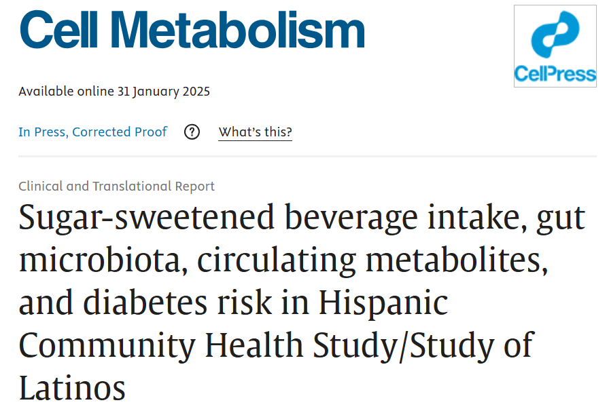
?????
https://www.sciencedirect.com/science/article/pii/S1550413124004868?via%3Dihub

Slide 29
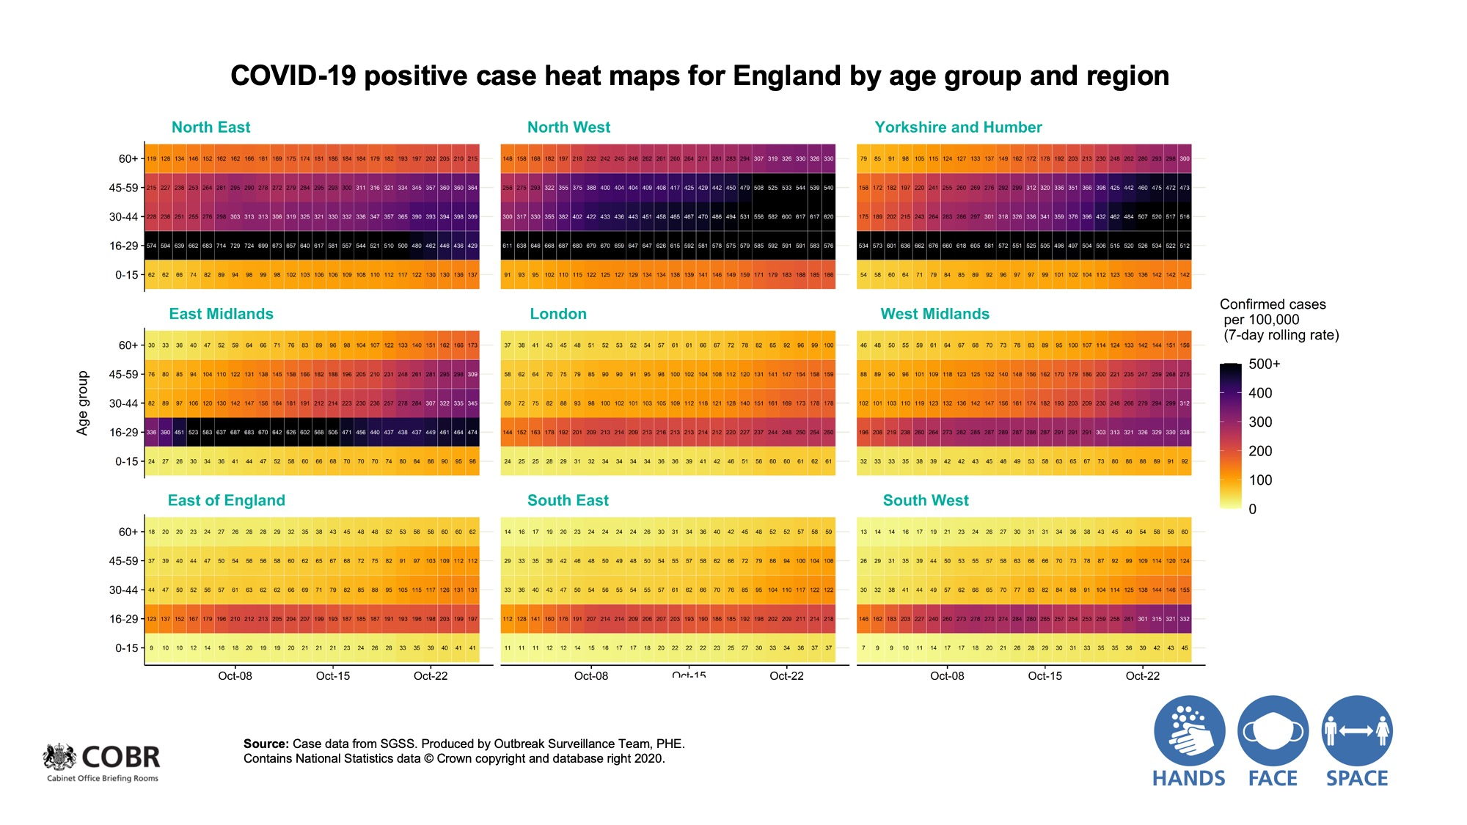
Over-plotting!

Slide 30
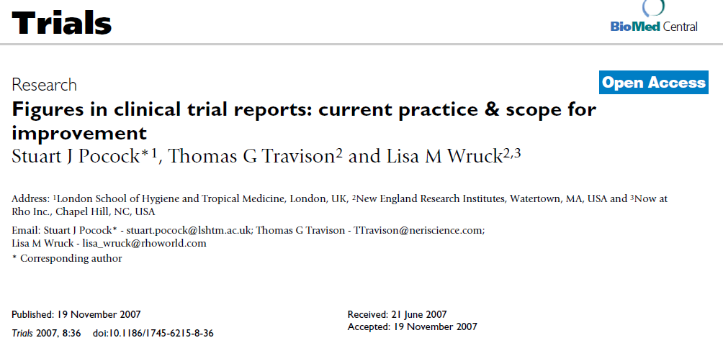
Tidiness, readability
Can I mod the error bars?
SD or CI
….

Slide 31
How to improve?
Mazzone et al. JAMA Dec 6, 2006 p2577

Slide 32
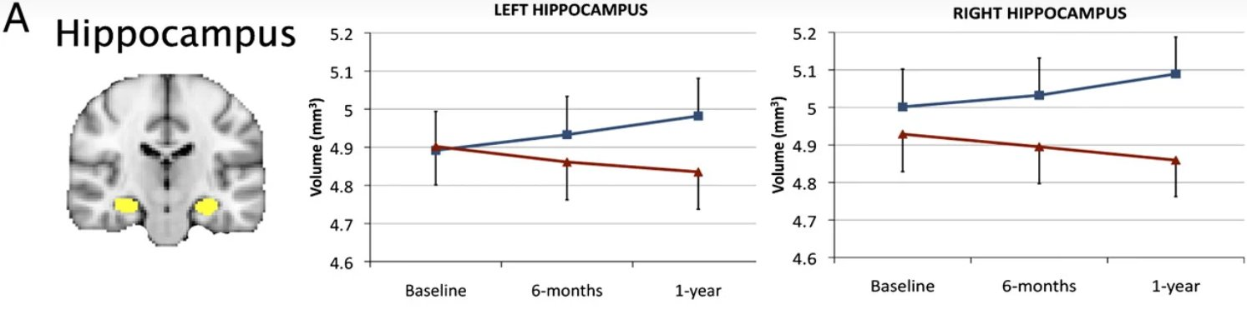
Cont. ----- what did this figure do right
(where could it improve?)
https://www.pnas.org/doi/10.1073/pnas.1015950108
Notes:
Color hue + Error bar only one side to make things less cluttered
No specific labeling of what each color means; gridline; font size for labeling

Slide 33
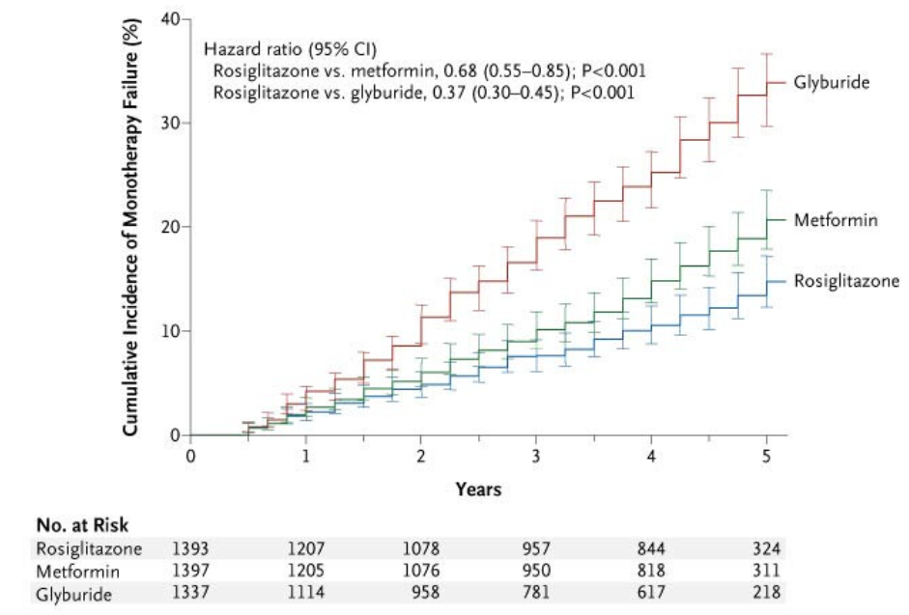
How to improve?
Kahn et al. NEJM Dec 7, 2006 p2433
Notes:
Figure 8 is a relatively rare example where the plot includes 95% CIs for the estimates over time. The end result in this case is a bit too cluttered, so it might have been better if these had been included at each year rather than every three months.
Or use shaded area instead of the error bars to depict CI

Slide 34
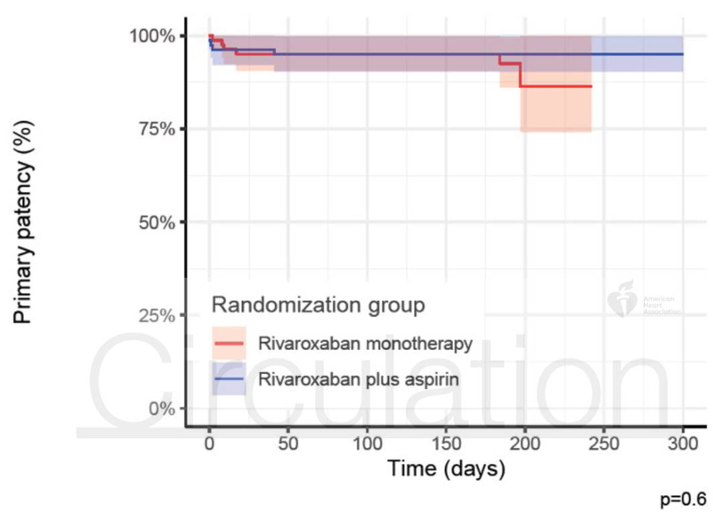
What’s wrong?
JAMA Jan 24, 2007 p384 (left); The ARIVA trial, Circulation, 2025 (right)

Slide 35
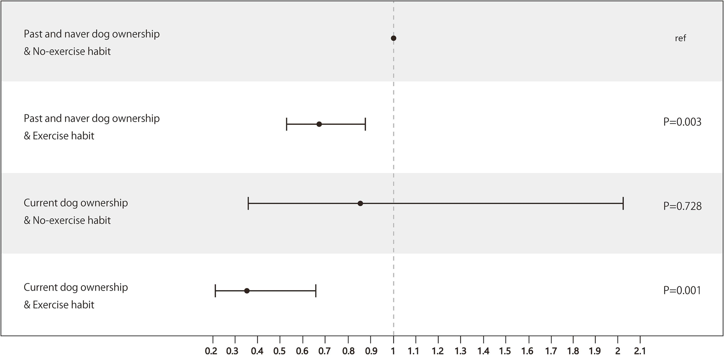
Dog ownership is associated with a reduced odds of dementia - cat ownership has no effect.

Slide 36
Dog ownership is associated with a reduced odds of dementia - cat ownership has no effect.
https://www.sciencedirect.com/science/article/pii/S221133552300356X

Slide 37
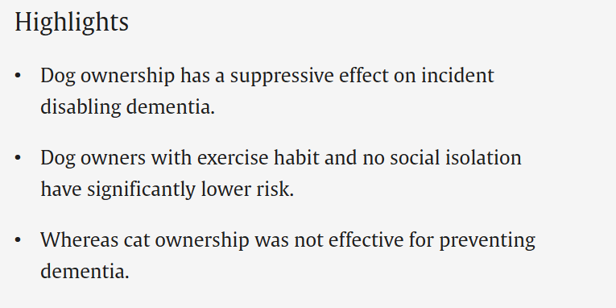
Dog ownership is associated with a reduced odds of dementia - cat ownership has no effect.
https://www.sciencedirect.com/science/article/pii/S221133552300356X

Slide 38
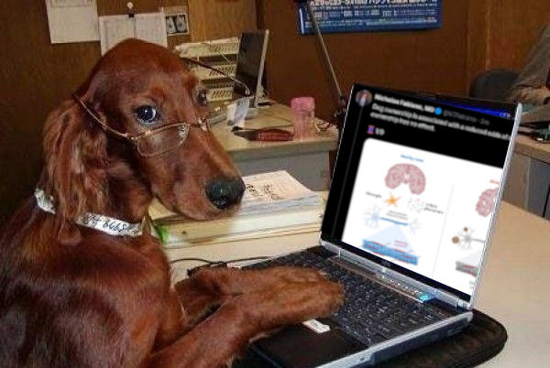
Paid for by big dog
https://www.sciencedirect.com/science/article/pii/S221133552300356X

Slide 39
Recap: considerations in making graphs
Is a graph really necessary?
Graph type
Visual channels
Color is not always bad
Avoid going full minimalist or too cluttered
Readability (font and label) and tidiness (tick, gridline)
***vector images: easier for figure editing
Notes:
Rainbow color spectrum not recommended

Slide 40
Vector files!!!!
Excel --------- direct copy-paste
GraphPad Prism --------- .emf or .wmf (or copy-paste)
SAS, SPSS, STATA, etc. --------- .svg, .eps, etc
R (ggplot2), Python (Matplotlib) --------- .pdf. etc

Slide 41
Assemble figures
Powerpoint (!)
Adobe Illustrator > Photoshop
*Illustrator excels in handling vector objects/files much
Inkscape
BioRender (web-based)
  *DOS-subsidized license for PI; good for graphic abstract; ok-ish for poster; not ideal for publication

Slide 42
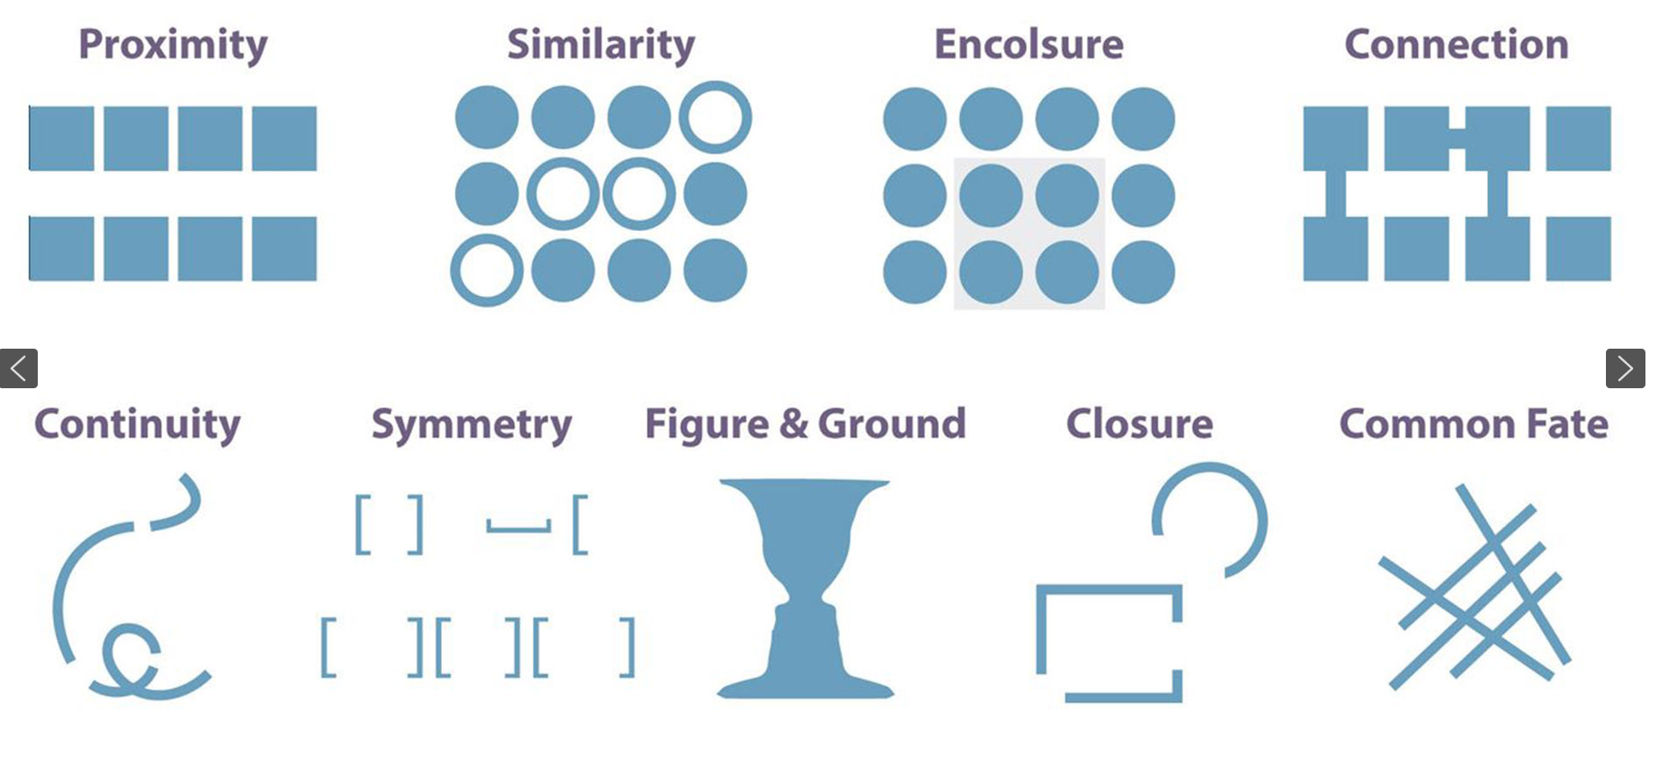
7 Gestalt Principles

Slide 43
Considerations in assembling figures
What’s the purpose/target audience?
Consistency
Readability
Easily editable
Pick the tools you like
(Excel = = Illustrator but >BioRender)
For trainees: sharable and editable with PI&co-authors
Notes:
Tailor the complexity and design of your visuals to the expertise and interest of your audience.
Example: A graph used in a grant proposal may need to be simplified for a general scientific audience at a conference; but that same graph in your grant may be far too simplified for a manuscript

Slide 44
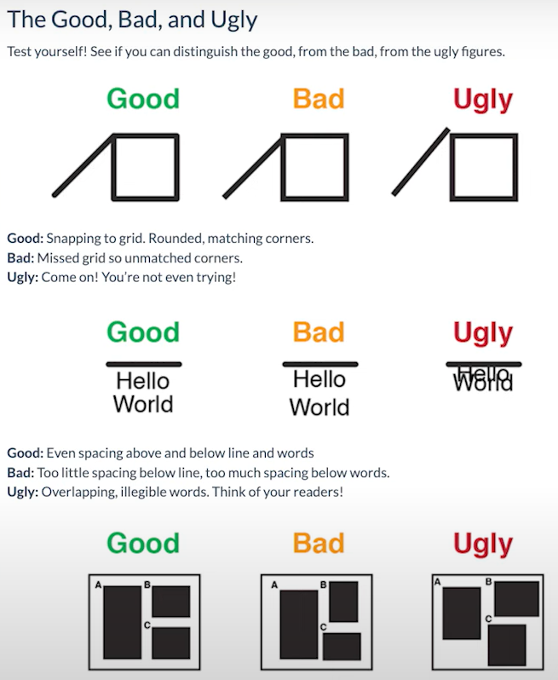

Slide 47
Is that so?

Slide 48
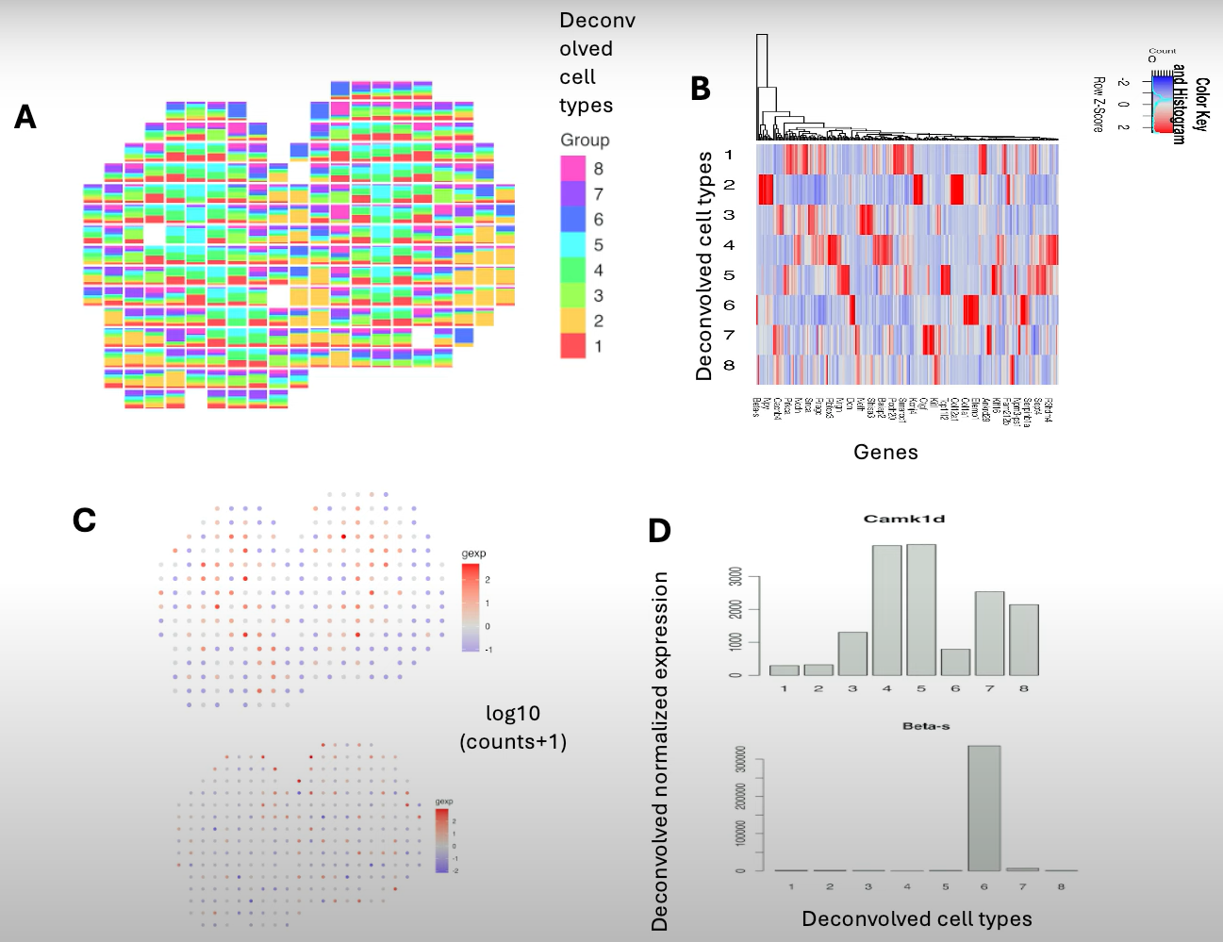
How to improve

Slide 49
How to improve

Slide 50
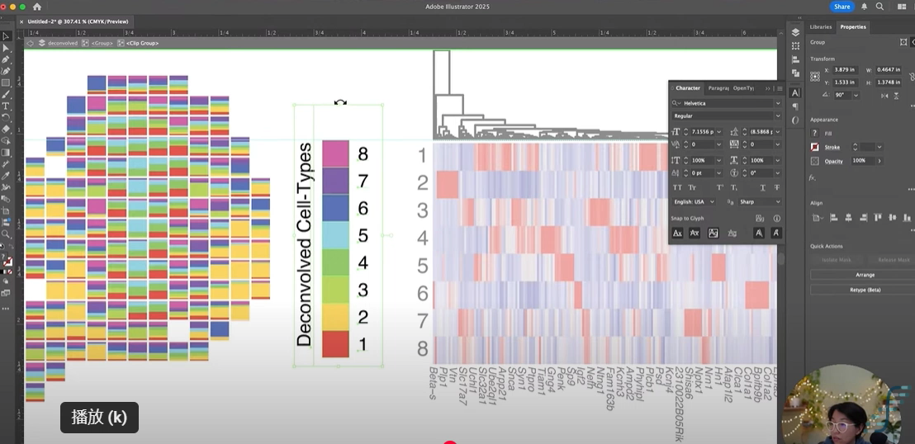

How to improve
https://youtu.be/L9qo2XZiQ4Y?si=vV7qrWUMOV-l0NMG

Slide 51
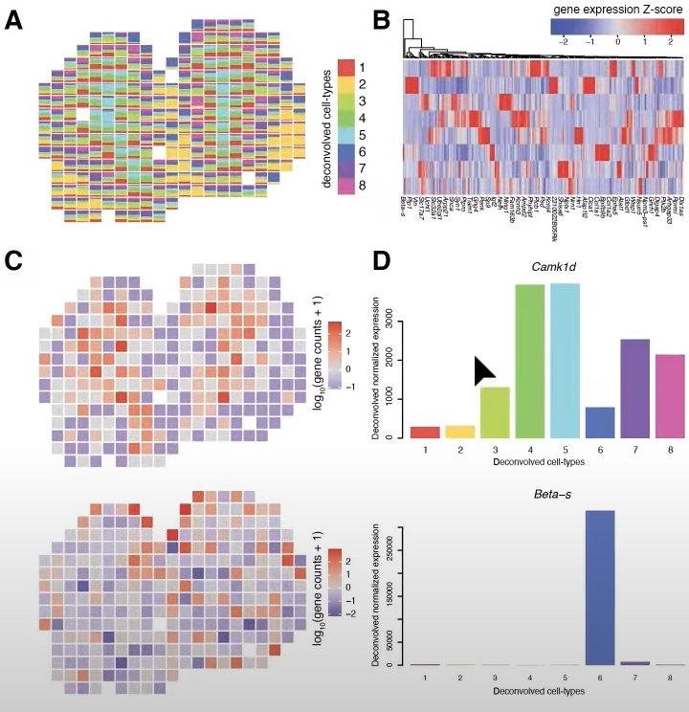
How to improve

Slide 52
From this….

Slide 53
How to improve

Slide 54
How to improve

Slide 55
How to improve
C
D

Slide 56
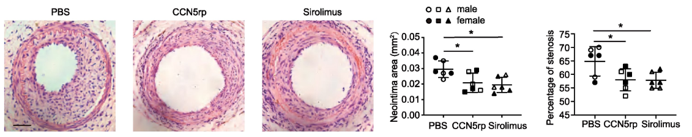
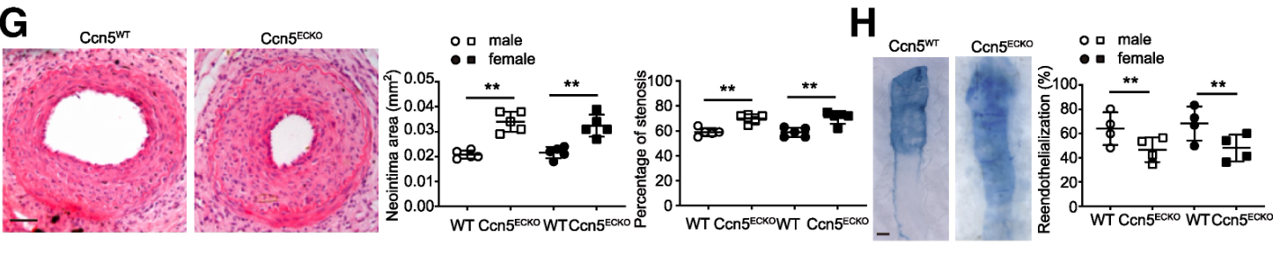
What’s wrong?
https://academic.oup.com/eurheartj/advance-article/doi/10.1093/eurheartj/ehae911/7985326

Slide 57
Inconsistency; text size; … but aligned
https://academic.oup.com/eurheartj/advance-article/doi/10.1093/eurheartj/ehae911/7985326

Slide 58
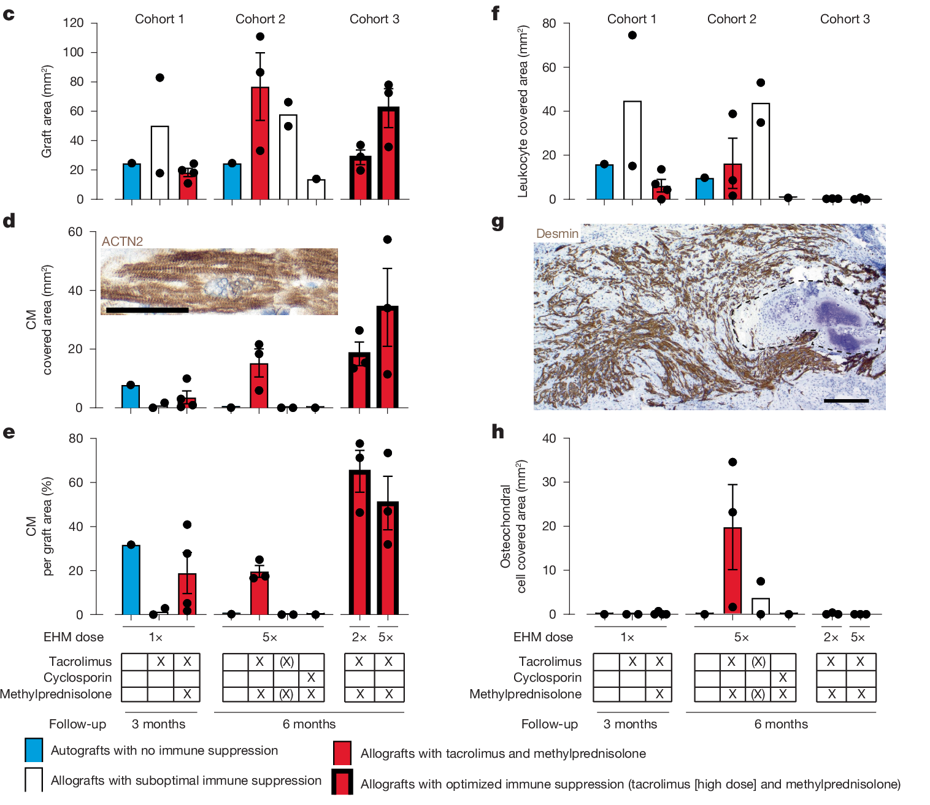
Mixed feeling

Slide 59
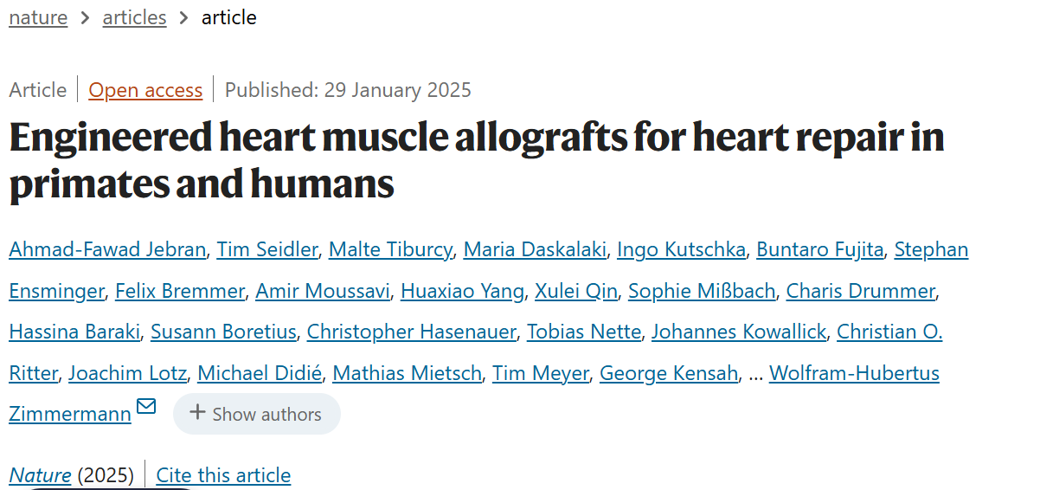
Consistency + visual channels + aligned
Readibility+legend
https://www.nature.com/articles/s41586-024-08463-0

Slide 60
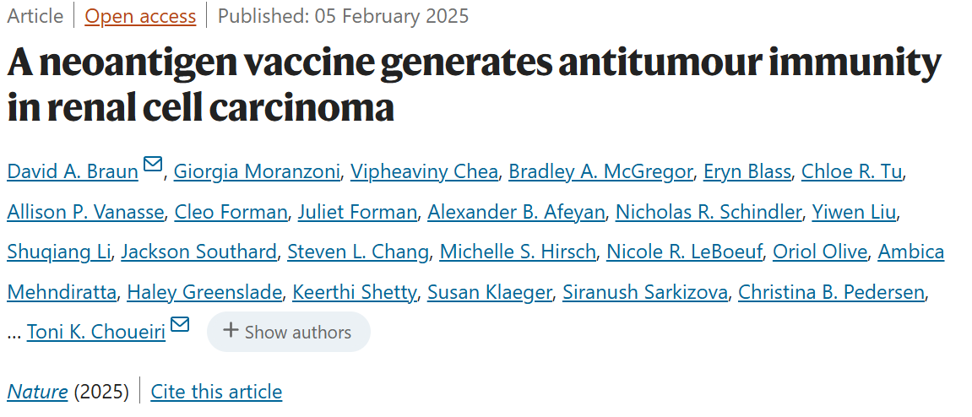
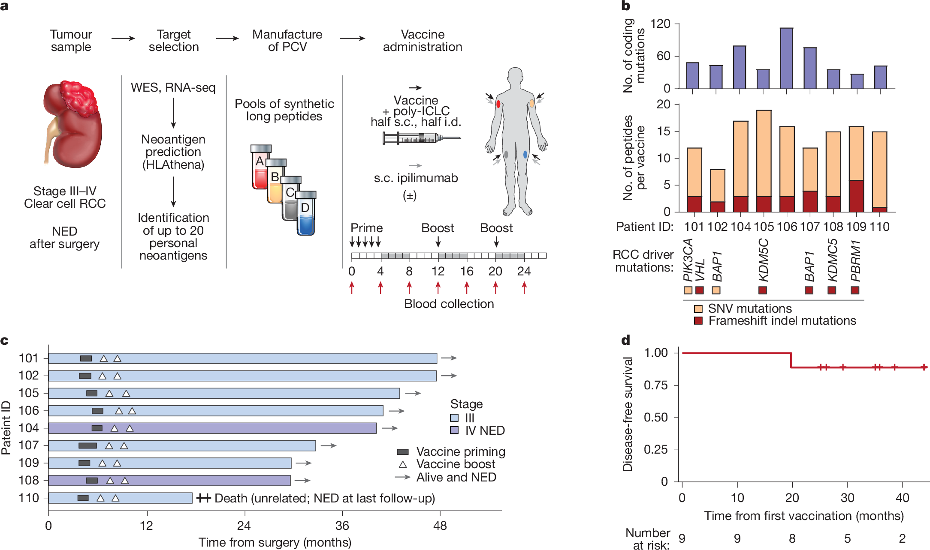
Comments?
https://www.nature.com/articles/s41586-024-08507-5

Slide 61
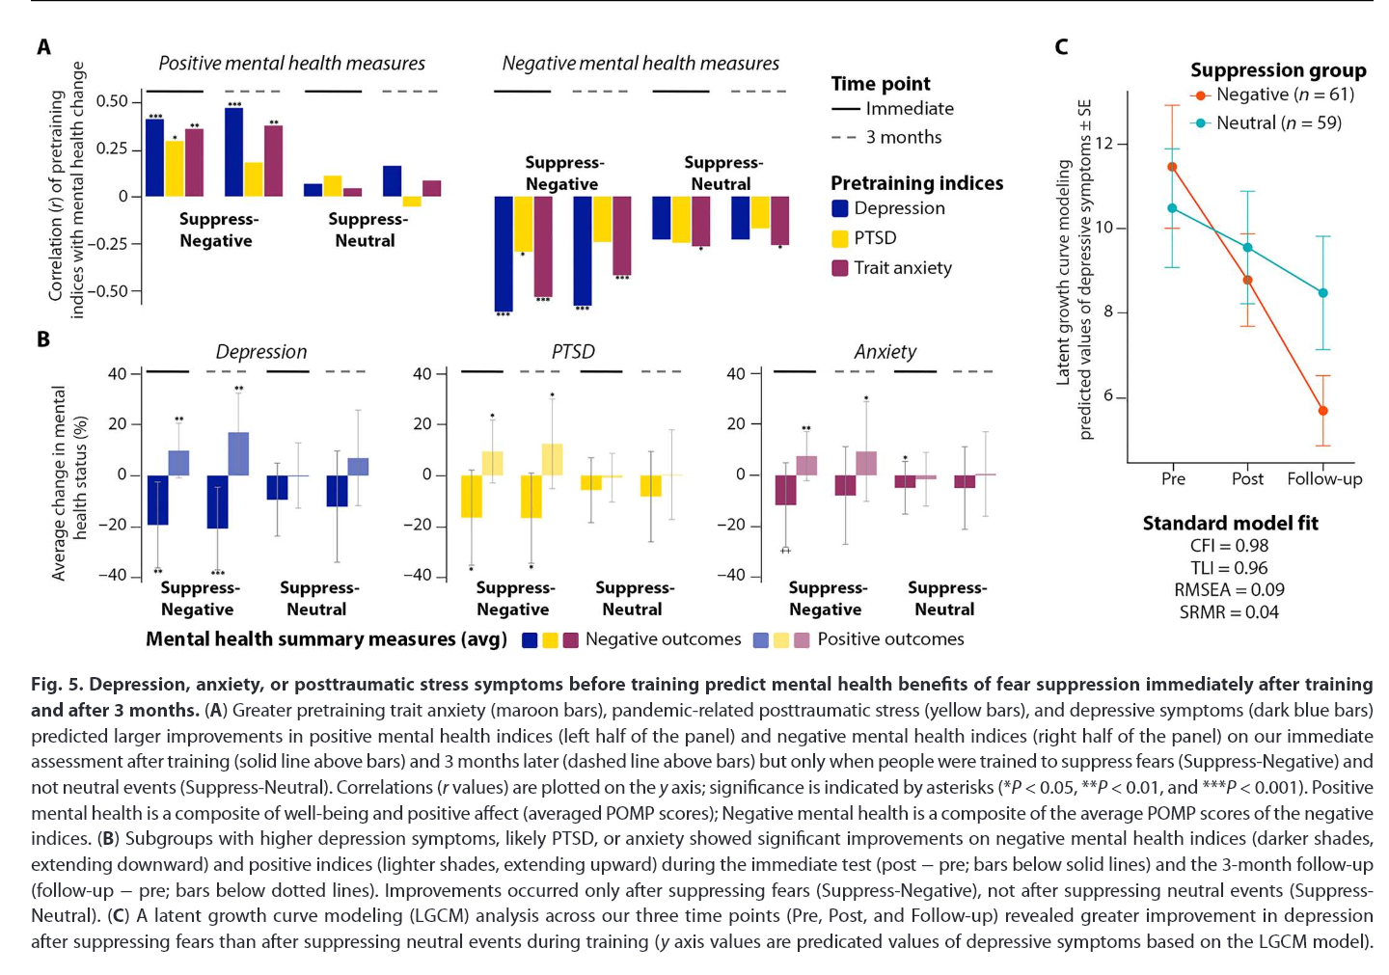
Comments?
https://www.science.org/doi/10.1126/sciadv.adh5292

Slide 62
Comments?
https://www.science.org/doi/10.1126/sciadv.adh5292

Slide 63
Comments?
How to improve:
-definitely NOT sequential colors (e.g. blue vs light blue)
-maybe divergent colors? But there are already too many colors there
-combining other visual channels (e.g., different fillings? Outlines? Bar shapes)
https://www.science.org/doi/10.1126/sciadv.adh5292

Slide 64
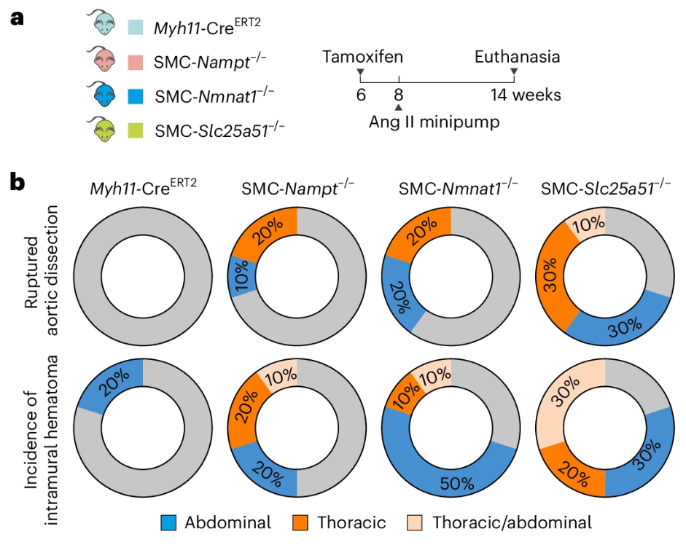
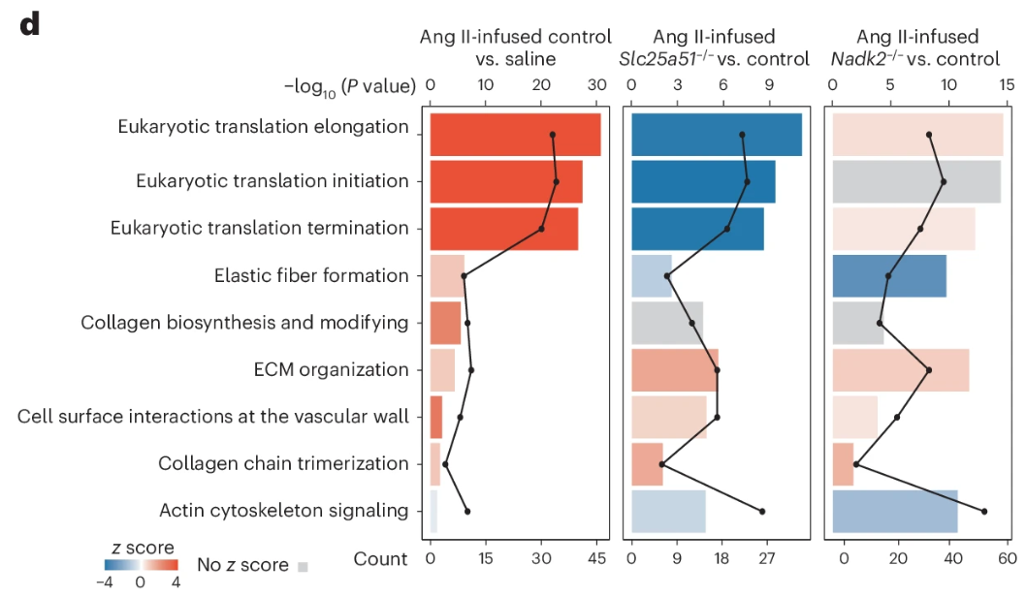
Comments?
https://www.nature.com/articles/s44161-024-00606-w
Notes:
Good schematics. Nice choice of colors

Slide 65
Pie chart? Unnecessary line? Readibility?
https://www.nature.com/articles/s44161-024-00606-w

Slide 66
DataViz Strategies for Different Purposes
Scientific publication
Conference presentation
Grant proposal
Graphic abstract
Scientific dissemination to the general public
Pitch talk to key stakeholders (INVO Forward)
Notes:
Precision and Detail:Visuals must convey detailed scientific data accurately and allow for close examination.
Example: High-resolution scatter plots or heat maps in genomics.
Adherence to Guidelines:Many journals have specific requirements for figures regarding size, format, and color palette (e.g., CMYK for print).
Tip: Check the journal’s instructions for authors carefully to ensure compliance.
Enhancing Readability:Use annotations and supplementary legends to explain complex data.
Ensure that all elements are visible and clear when resized to the journal’s column width.

Slide 67
DataViz for conferences?
Clarity and impact
Engagement
Succinct, clear, easily understandable (1 graph/slide)
Readability: BIG FONT SIZE!
Only highlight/show figures that are critical!
Notes:
Clarity and Impact:The goal is to catch and hold the attention of an audience in a potentially large and diverse room.
Example: Simplified bar graphs or pie charts to show key data points clearly.
Engagement:Use bold, attention-grabbing colors and larger fonts to ensure visibility from the back of a room.
Consider incorporating animations or interactive elements if the format allows.
Time Constraint:Conference presentations are often limited in time, necessitating visuals that can be quickly understood.
Tip: Focus on major takeaways, using the visualization to reinforce your spoken words.

Slide 68
DataViz for grant proposal!
Space, space, space!
Scientific premise: fit your narrative
Persuasive
Clarity (not so much about simplicity though)
Notes:
Supporting the Narrative:Visuals should help build a compelling story that underscores the necessity and impact of the proposed research.
Example: Flow diagrams to outline the project methodology or timelines for projected milestones.
Persuasiveness:Use visuals to highlight preliminary data or past successes that support the feasibility of the project.
Include graphs that clearly demonstrate the potential impact and benefits of the research.
Simplicity and Clarity:Since reviewers may skim through many proposals, visuals need to be immediately comprehensible.
Tip: Avoid overly complex visualizations; opt for clear, straightforward graphics that can be understood at a glance.

Slide 69
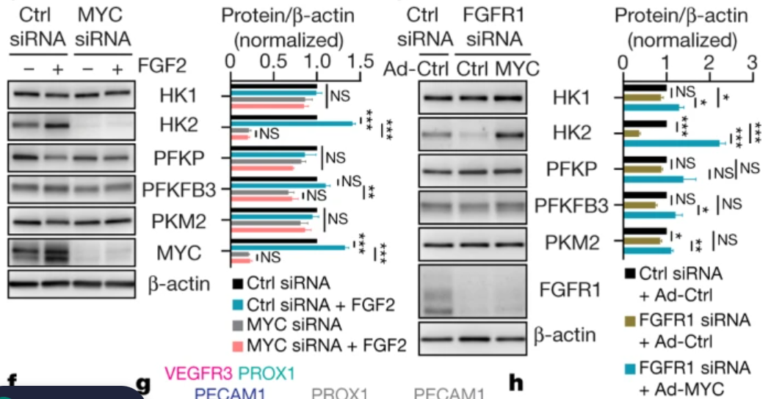
Here’s an example

Slide 70
If this were for a manuscript…..

Slide 71
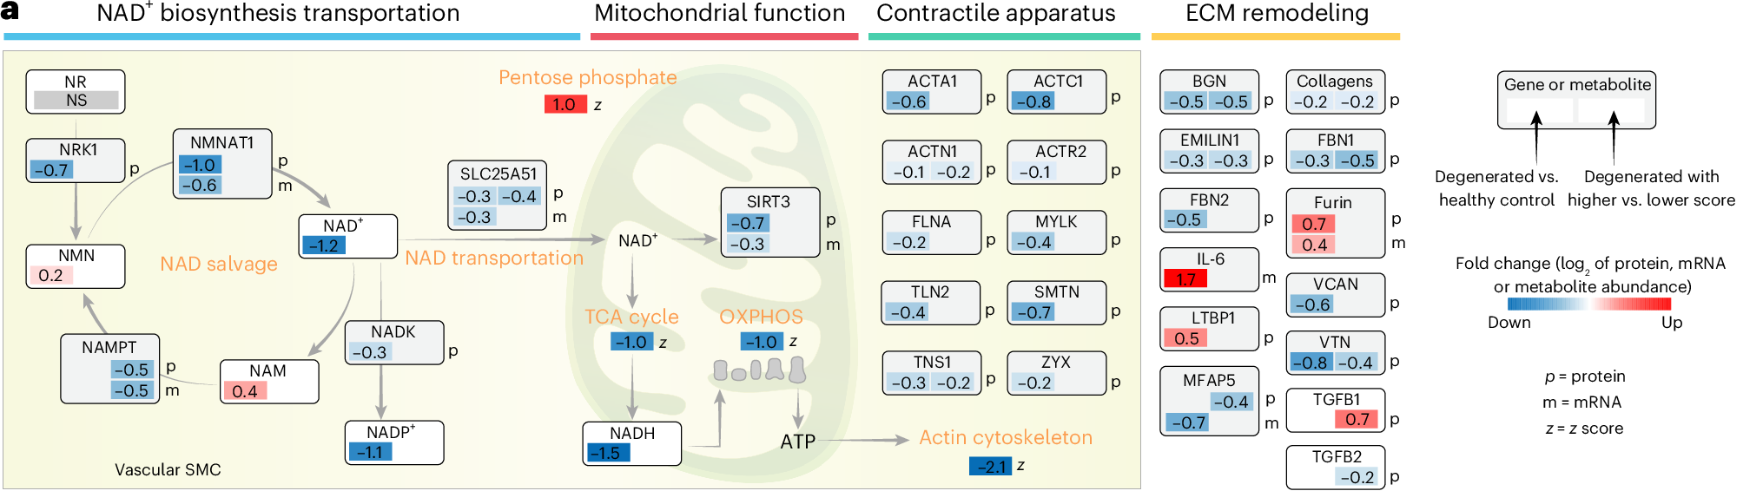
If this were for a manuscript…..

Slide 72
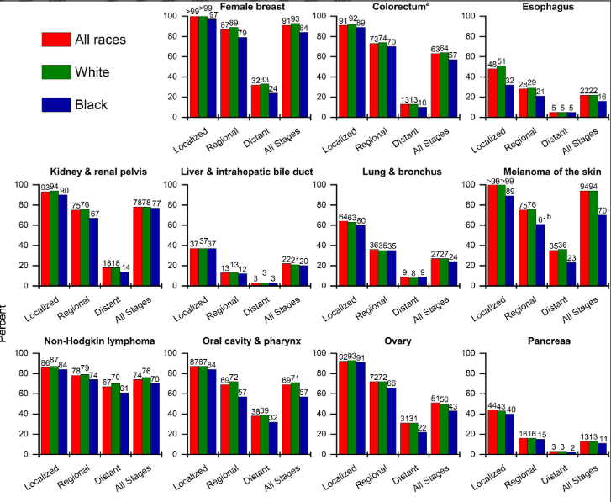
If this were for a manuscript…..
https://acsjournals.onlinelibrary.wiley.com/doi/10.3322/caac.21871

Slide 73
If this were for a conference presentation

Slide 74
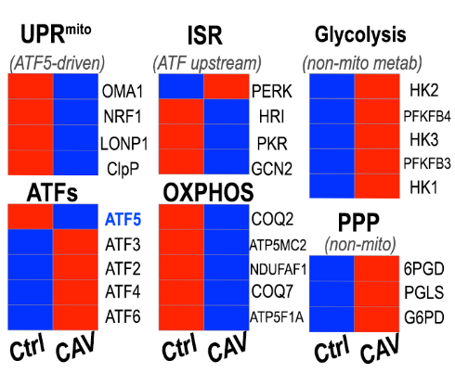
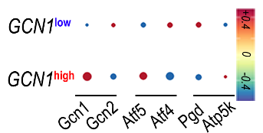
If this were for a grant
Notes:
Losing certain information (such as the error bar and data distribution) but gain clarity and space

Slide 75
Recap: considerations in assembling figures
What’s the purpose/target audience?
Consistency
Readability
Easily editable
Pick the tools you like
(Excel = = Illustrator but >BioRender)
For trainees: sharable and editable with PI&co-authors
Notes:
Tailor the complexity and design of your visuals to the expertise and interest of your audience.
Example: A graph used in a grant proposal may need to be simplified for a general scientific audience at a conference; but that same graph in your grant may be far too simplified for a manuscript

Slide 76
Summary
I intentionally left this blank

Slide 77
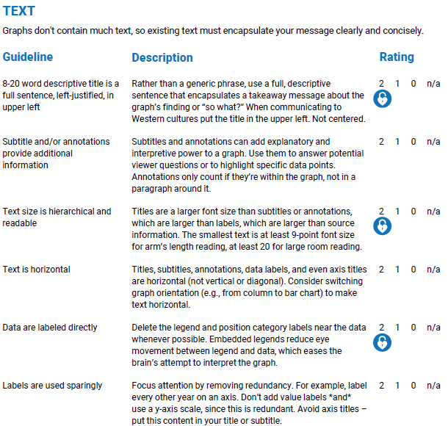
*DataViz Checklist @EvergreenData

Slide 78
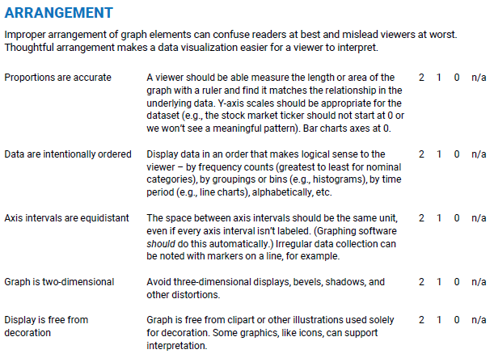
*DataViz Checklist @EvergreenData

Slide 79
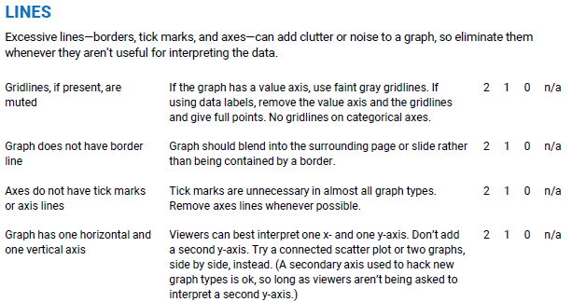
*DataViz Checklist @EvergreenData

Slide 80
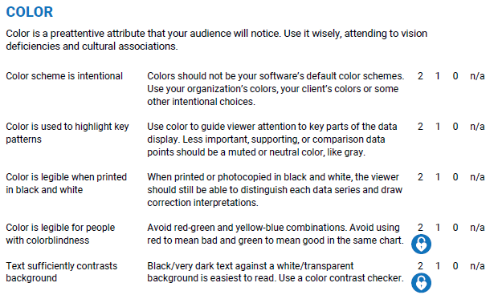
*DataViz Checklist @EvergreenData

Slide 81
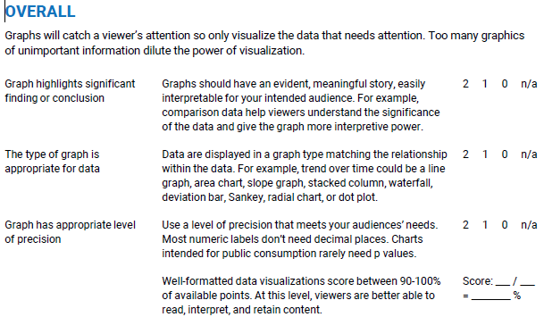
*DataViz Checklist @EvergreenData
Earlier iterations of this Checklist were made in partnership with Ann K. Emery. Dr. Sena Sanjines contributed to refinement through validity and reliability tests.

Slide 82
Considerations in making graphs
Is a graph really necessary?
Graph type
Visual channels
Color is not always bad
Avoid going full minimalist or too cluttered
Readability (font and label) and tidiness (tick, gridline)
***vector images: easier for figure editing

Slide 83
Considerations in assembling figures
What’s the purpose/target audience?
Consistency
Readability
Easily editable
Pick the tools you like
(Excel = = Illustrator but >BioRender)
For trainees: sharable and editable with PI&co-authors

